Slide 1
Move in, Move Out, Customer Transfers, and Owner Allocation Workshop A-2: Manage Customer Move Out Mohanta Das, Jose Diaz 6/2/26

Slide 2





Overarching Design Principles
The goal of this project is to utilize standard Service Cloud V2 capabilities with minimal customizations. We will strive to modify our processes to Fit-to-Standard SAP technology as much as possible.
SAP First
We will adopt an “SAP first” strategy with all financial and operational data housed within SAP.
Fit to Standard
Rationalize Applications
We will change and adapt our existing business processes to fit to standard ‘out of the box’ functionality.
We will standardize and rationalize our applications to control costs and reduce the complexity of our IT estate.
Minimize customizations
‘Best of Breed’ by exception
Non-SAP applications will only be considered if they are considered ‘best of breed’ and are necessary to enable competitive advantage or meet complex regulatory requirements.
We will minimize customizations and keep the core clean to ease future upgrades, improving agility and scalability.

Slide 3
Workshop Agenda
TOPIC
01
Purpose
(L3) Move Out
BREAK – 10 Mins
Current and Future State Assumptions
FRICE-W
Drafted User Stories
Decisions, Action Items, Change Impacts, Wrap-Up, and Next Steps
02
03
04
05
05
06

Slide 4
01 Scope, Purpose, Objective

Slide 5
Scope, Purpose, Objectives
Scope
Purpose
Objective
Scope of this document covers the to-be state of the Move Out Process for SAP Service Cloud v2 and SAP S4HANAer
Describe and confirm the Move Out Process
Offer a holistic view of all the key elements of the to-be process including organization/roles, configuration or customization if needed, data, reporting, security, and controls requirements.
Define the target-state ownership and L3 processes.
Document key assumptions/decisions and outline any FRICE-W's and reports.

Slide 6
Ownership
Workshop/PDD | Level 1 | Level 2 | Level 3 | Teams Impacted | Business Process Owner | Reviewer
18.0 A-1 Process Customer Move-In, Move-Out, Transfers, and Manage Owner Allocation | Manage Customer Service | Process Customer Move-In, Move-Out, Transfers, and Manage Owner Allocation | 18.1 Manage Customer Move in | Customer, WAM | Tarah Wilson, Dawn Pettengill | Customer Core Team
 |  |  | 18.2 Manage Customer Move out | Customer, WAM | Tarah Wilson, Dawn Pettengill | Customer Core Team
 |  |  | 18.3 Manage Customer Transfer | Customer, WAM | Tarah Wilson, Dawn Pettengill | Customer Core Team
 |  |  | 18.4 Manage Landlord/Tenant | Customer | Tarah Wilson, Dawn Pettengill | Customer Core Team
WORKSHOP FACILITATION
Facilitator: Mohanta Das, Jose Diaz
IBM Scribe: Taylor Ilov
Change Impacts: Julie Vandblarcum
CE PARTICIPANTS
Global Process Owner: Tarah Wilson, Dawn Pettengill
SMEs

Slide 7
03 (L3) Manage Customer Move Out

Slide 8
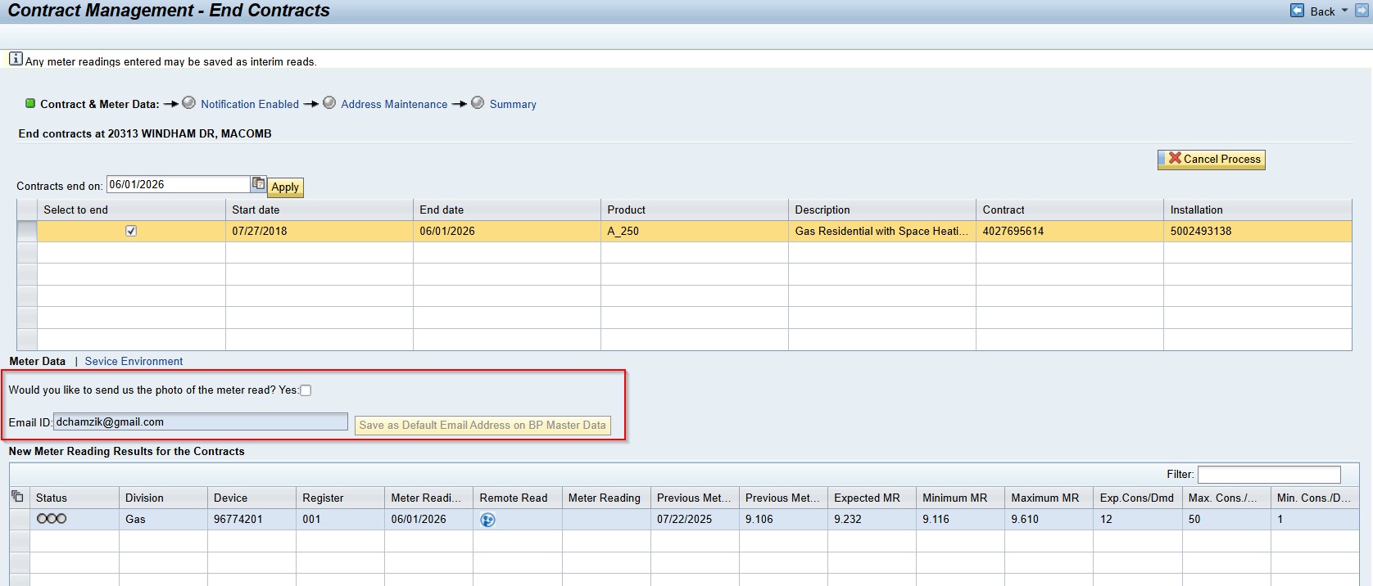
Process Overview- Move Out

Slide 9
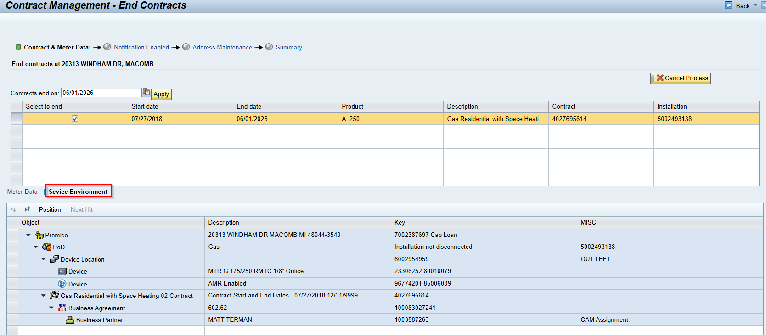
Process Overview- Move Out

Slide 10
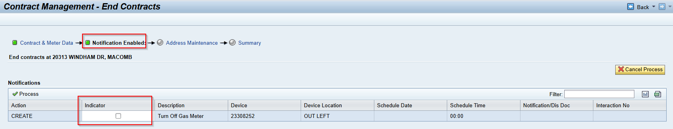
Process Overview- Move Out

Slide 11
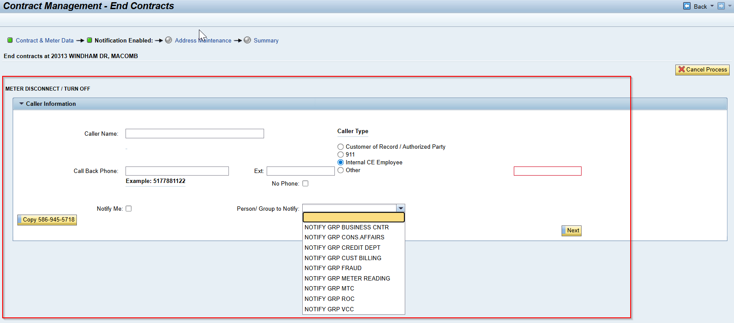
Process Overview- Move Out

Slide 12
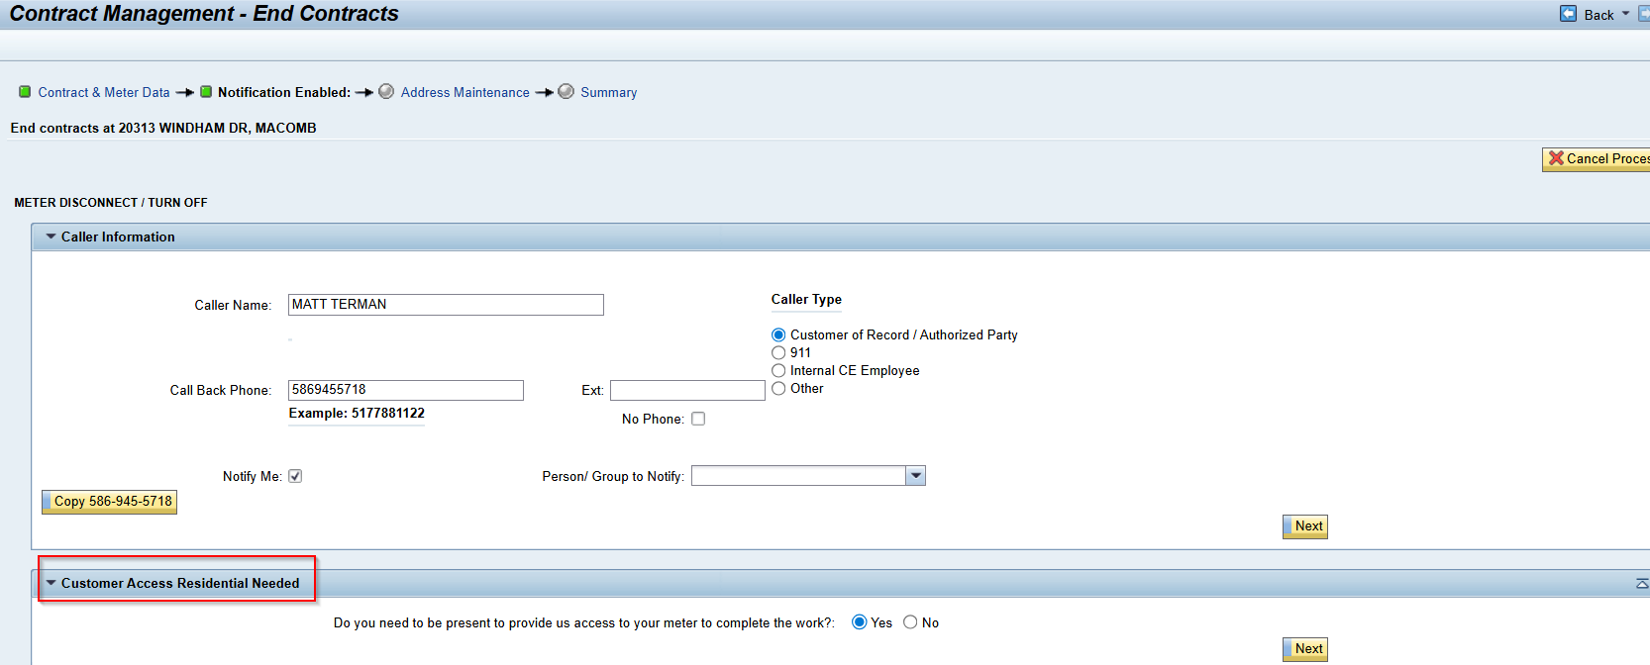
Process Overview- Move Out

Slide 13
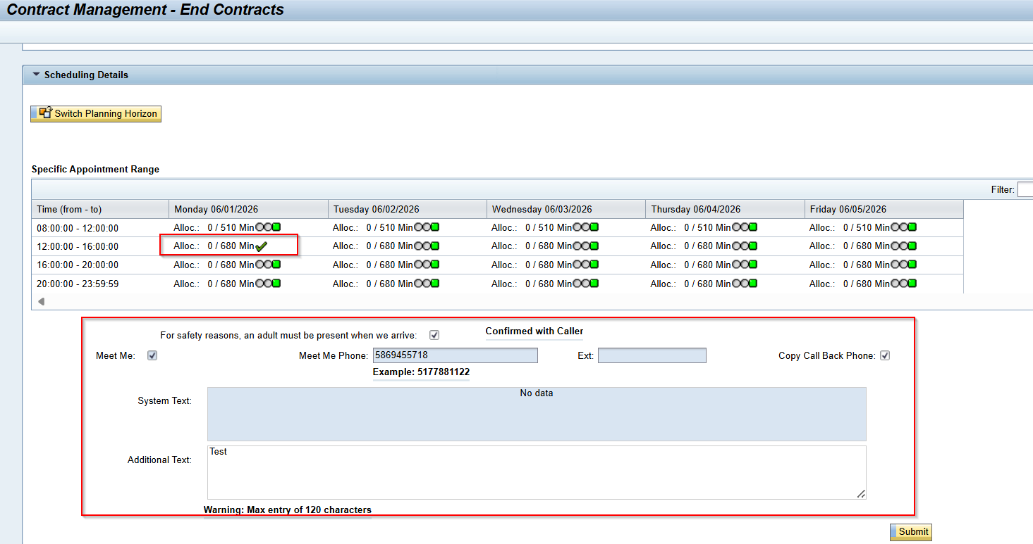
Process Overview- Move Out

Slide 14
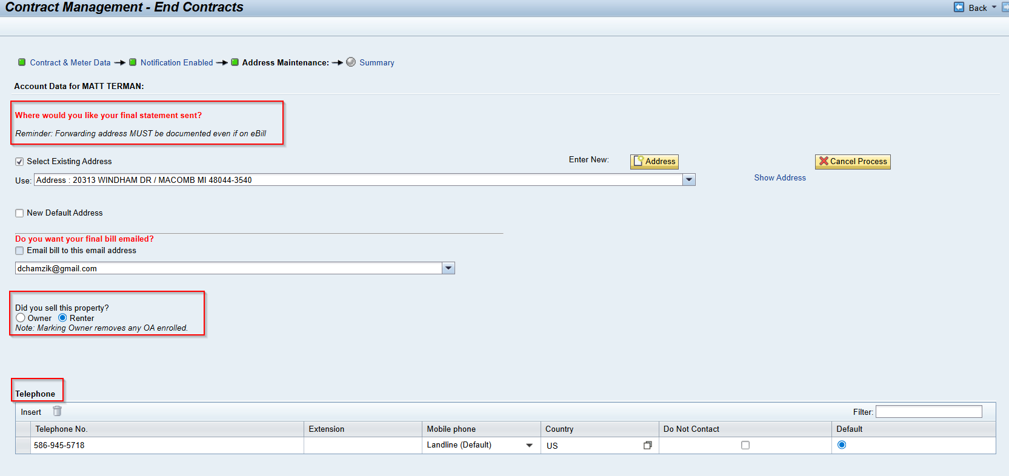
Process Overview- Move Out

Slide 15
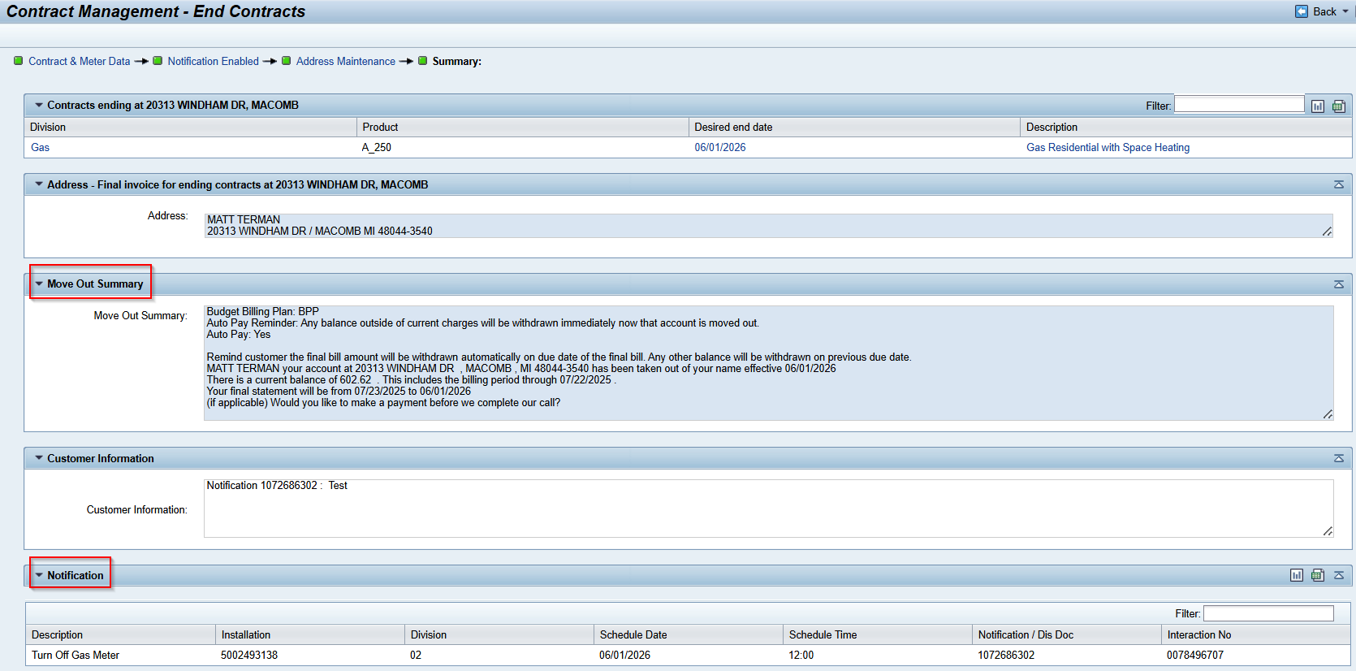
Process Overview- Move Out

Slide 16
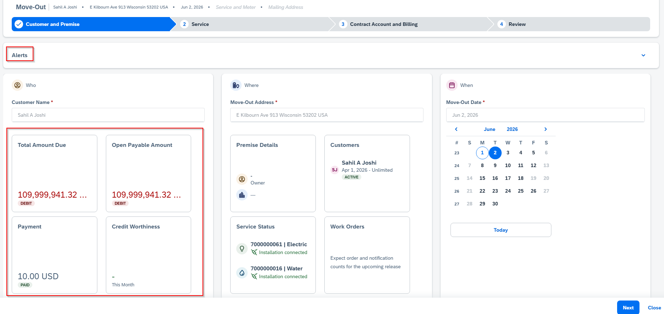
SAP Service Cloud Version2- Move Out

Slide 17
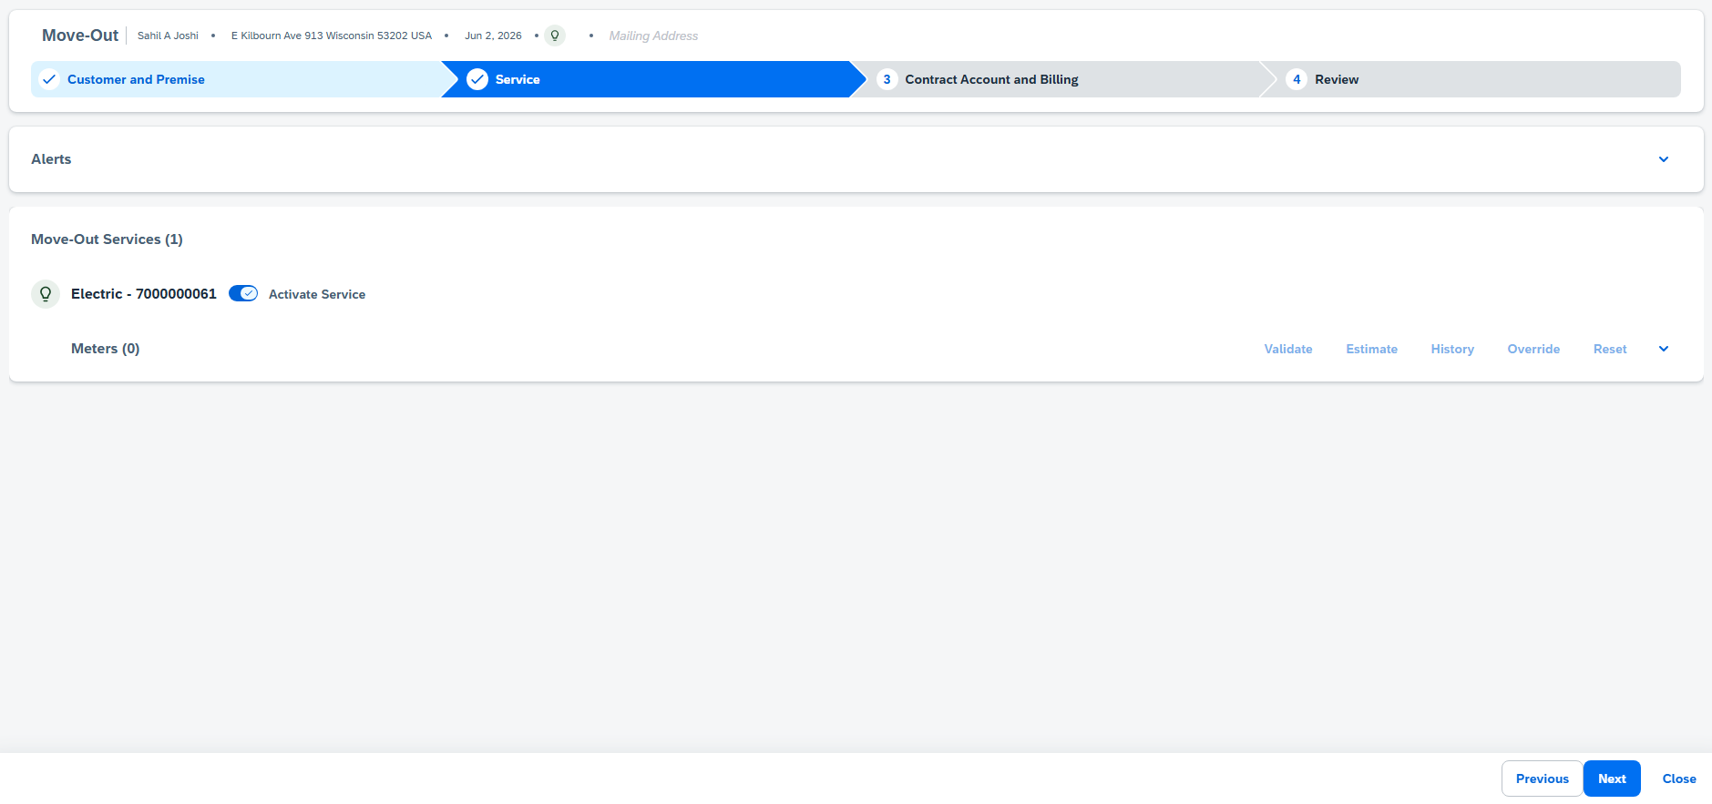
SAP Service Cloud Version2- Move Out

Slide 18
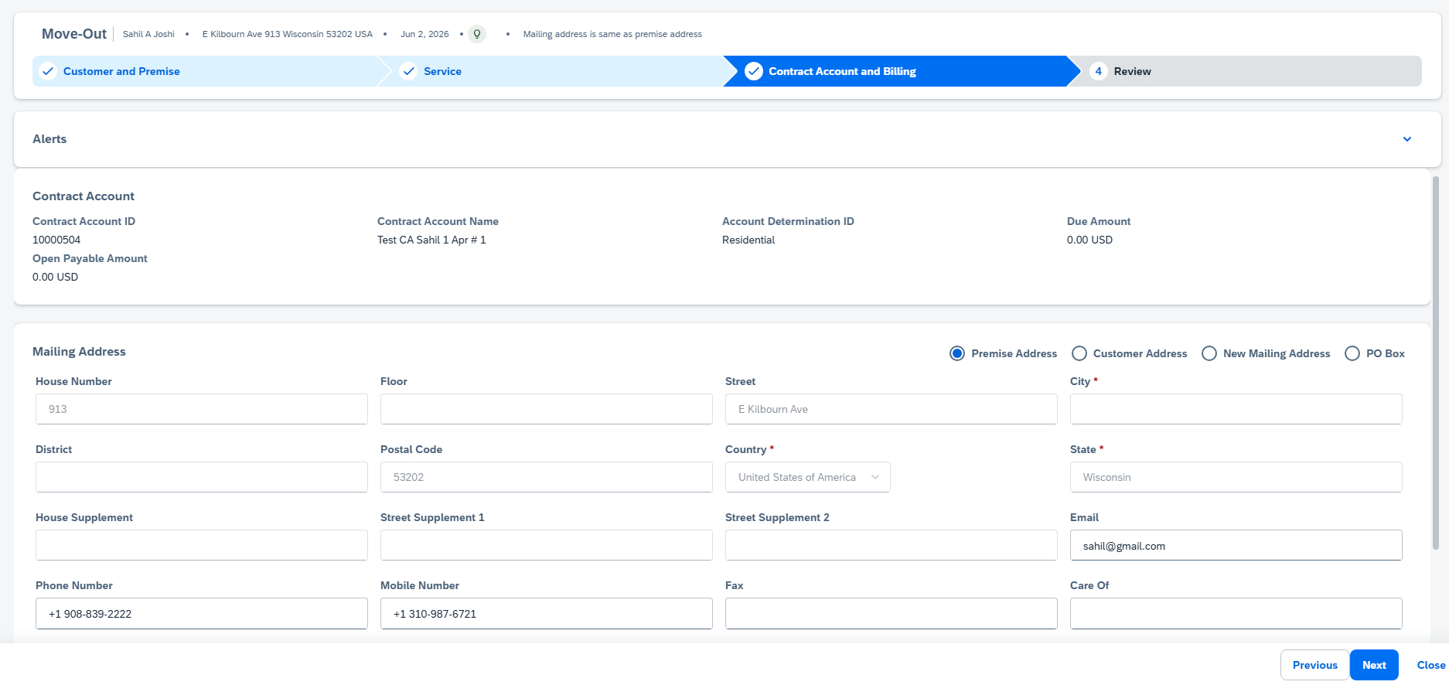
SAP Service Cloud Version2- Move Out

Slide 19
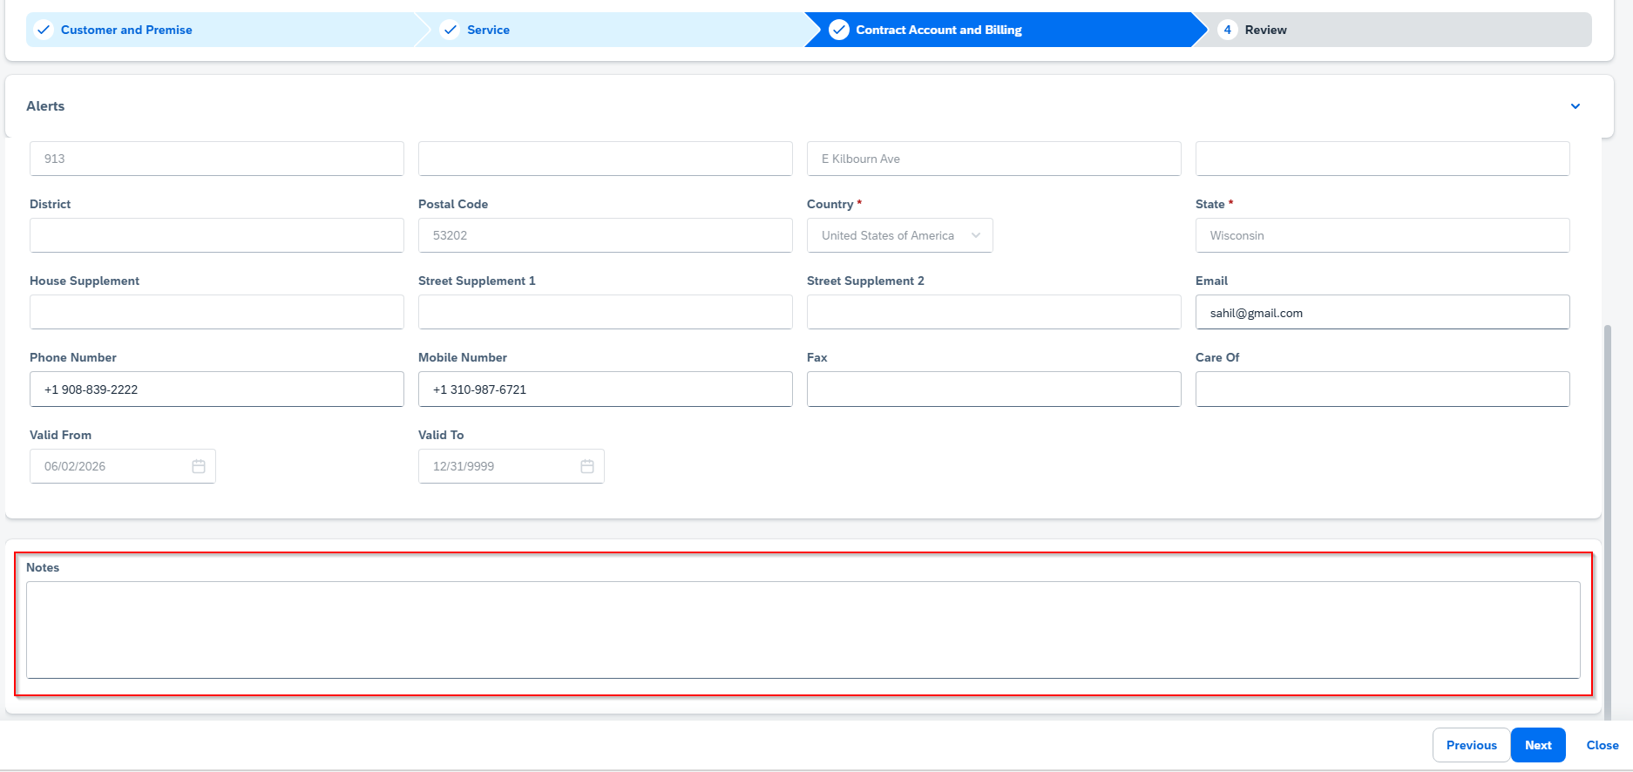
SAP Service Cloud Version2- Move Out

Slide 20
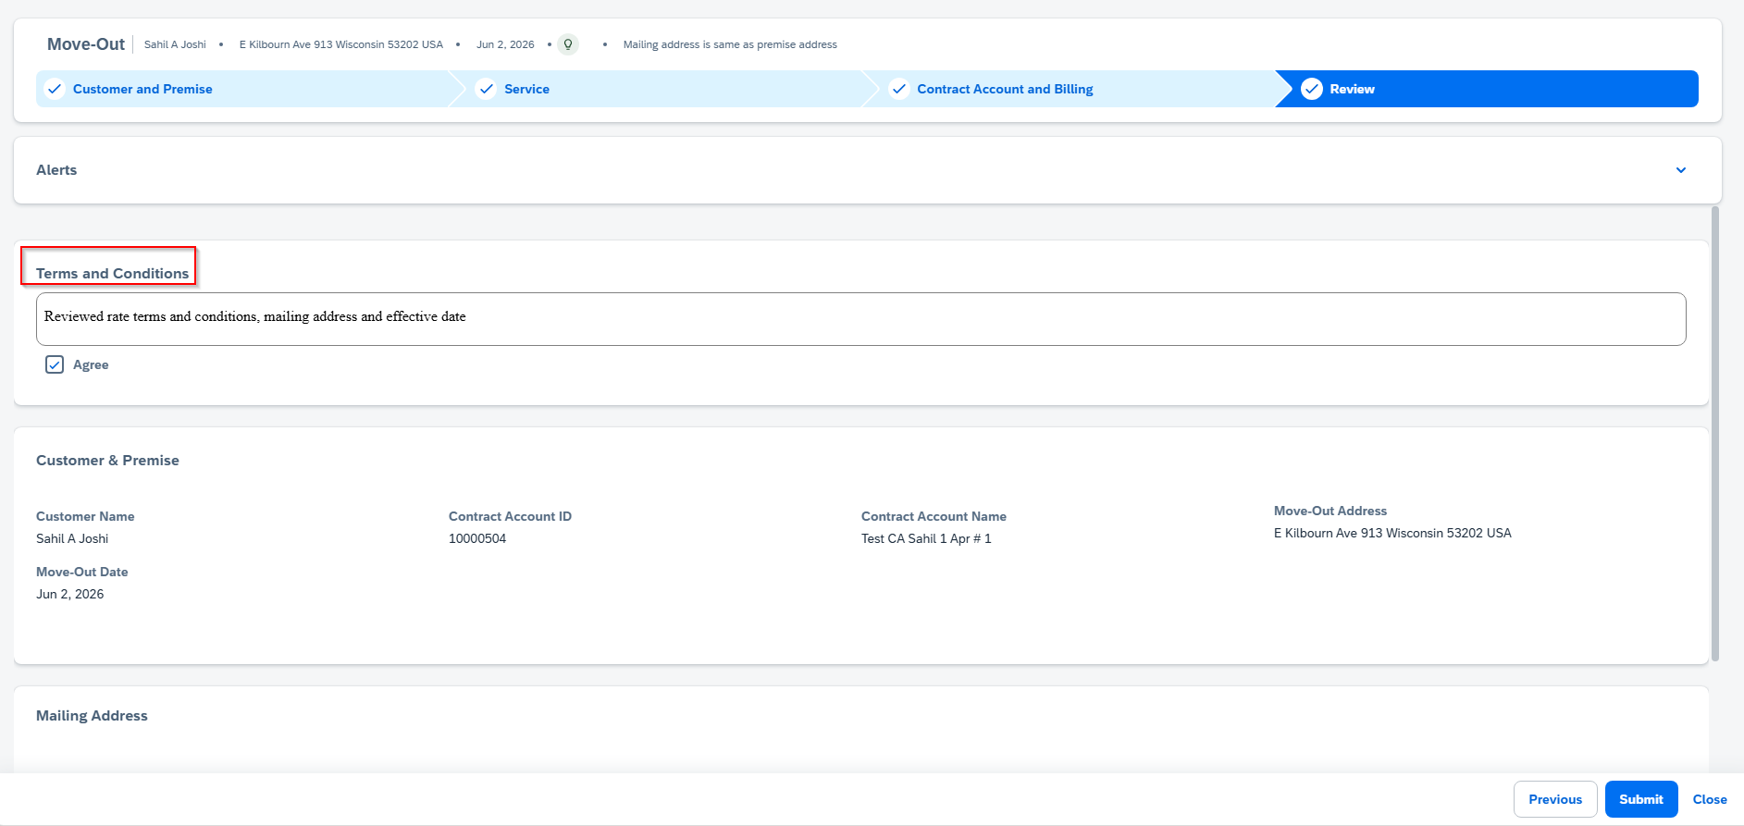
SAP Service Cloud Version2- Move Out

Slide 21
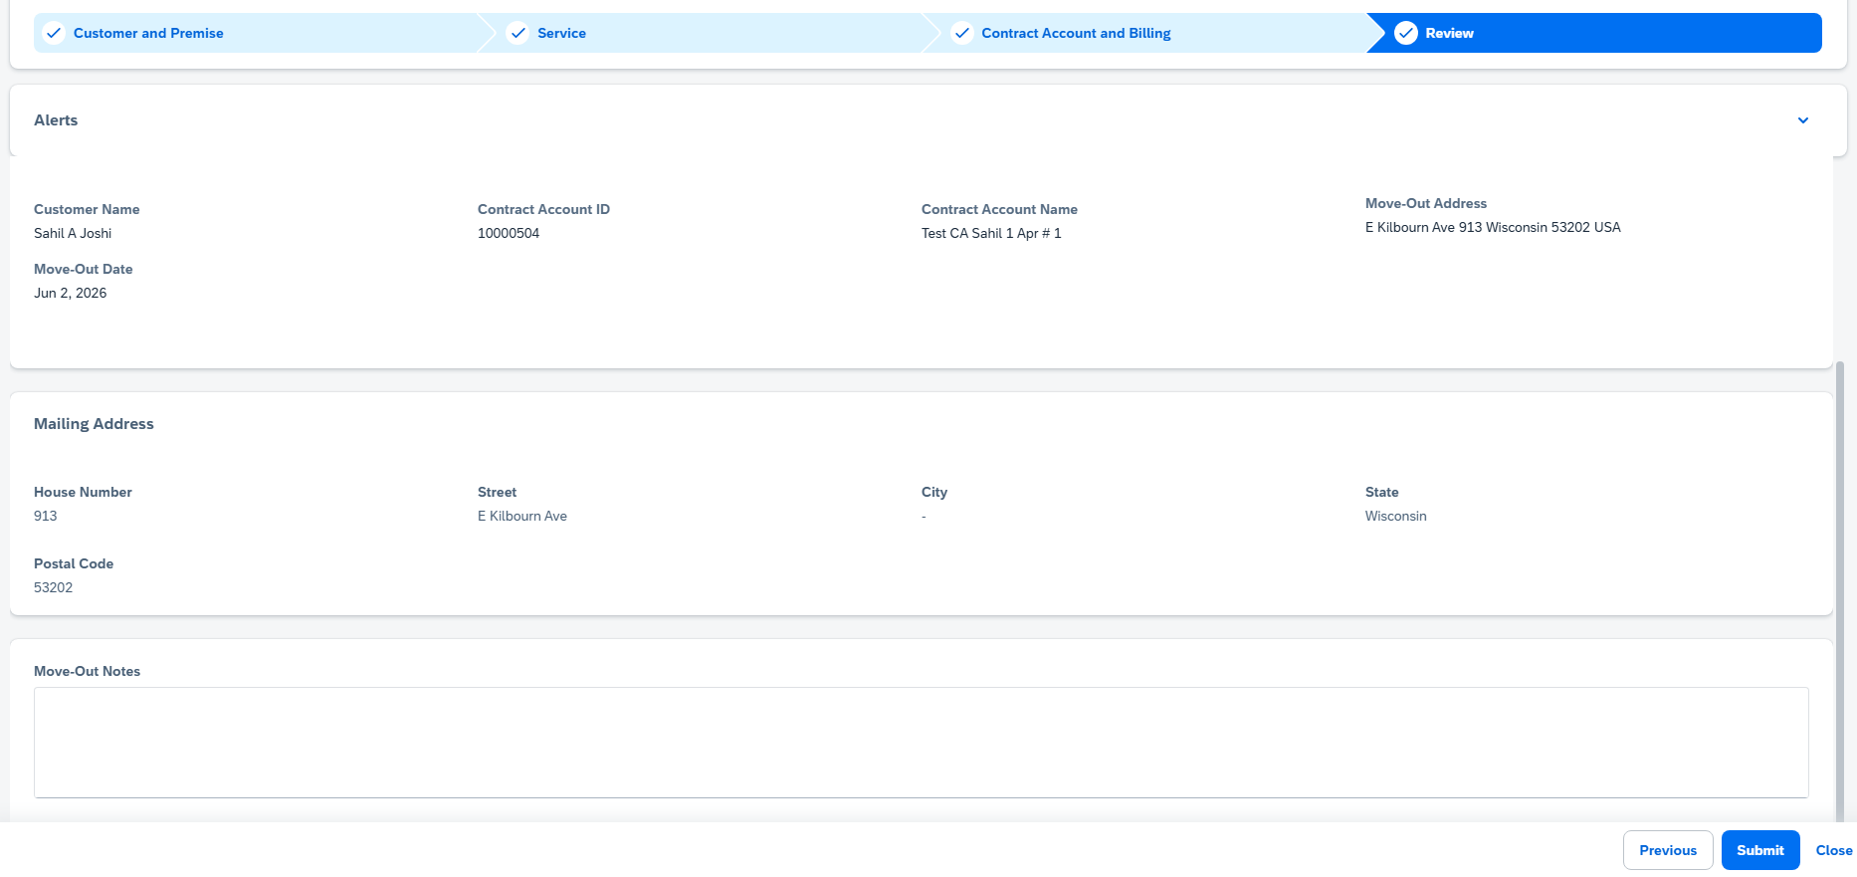
SAP Service Cloud Version2- Move Out

Slide 22
SAP Service Cloud Version2- Move Out

Slide 23
Move Out Workflow
Need to add for next workshop:
- Move In override for past due balances/ Hard Stop – let CSRs override move in?
- Carve out time in next workshop for Demand Enrollments
Cover MDT – Create on MDT that is existing today
add ASP identifier to search option for BP
+ RIDA 683615
Objects created on back of Move in | Criteria
Update Device Location Notes | If BP has Threat/Theft/Fraud Identification.
Update Contract Account with Dunning lock, 2. Outgoing payment type. | If Dunning scenario. Change Contract account out going payment type to Out Going Check(C)
Send SAP Document to position 70010050 70010051 | If BP has any ASP Contract (SD Contract), contracts gets cancelled. If Premise has CAP Loan. [ Customer Attachment Program ]
Create Disconnection document
Create Current Occupant if no owner allocation | Owner Allocation does not exist and service is on: If Current Occupant Move in required.
Create Contract Account for Current Occupant (Owner) | Current Occupant should move in automatically if no owner allocation and service is on.
Create Owner Move in | If OA exists on premise

Slide 24
BREAK! - 10 mins

Slide 25
03 Current and Future State Assumptions

Slide 26
CE Business Requirements:
Scenario
Appointment on Move Out- Turn off details like Caller Information, scheduling information.
Email Id- Customer to send meter read photo via email.
Add Telephone no.
Assumptions:
Objects and Technique
No Change in Workflow.
No Change in MDT.

Slide 27
04 FRICE-W

Slide 28
FRICE-W Identified
1. Move in field enhancements
2. Move out field enhancements
2. Enhancements in ECC may be required if looking for specific details in container from CRM7 now coming from v2 system.
3. Workflow changes in ECC may be required if looking for specific details in container from CRM7 now coming from v2 system.
4. Service Cloud enhancements to send custom container payloads for fields for certain scenarios.
5. DQM address cleanse
6. Create Contract Account Based on Current MDT Maintenance
7. Auto Populate Contract Account values
8. Create Service Orders
9. Premise enhancements
10. Enrollments
11. Security Deposits
12. Equifax check
13. Move in validations from ECC (i.e. Override past due balances)
14. Move in change event(s) placeholder
15. Move in cancel event(s) placeholder
16. Move out change event(s) placeholder
17. Move out cancel event(s) placeholder
18. Transfer items to new CA, new premise
19. change Rate, Operand
21. Smart Meter (Gas and Electric) Opt In/ Opt Out
22. Move Out Summary Script

Slide 29
05 Drafted User Stories

Slide 30
Drafted User Stories
L1 | L2 | L3 | L4 | User Story | Acceptance Criteria
Manage Customer Service | Process Customer Move-In, Move-Out, Transfers, And Manage Owner Allocation | Process Customer Move-In | Create Move-In | As a Customer Service Representative in SAP, I want to process customer move-in so that I can accurately create and record new move-in requests within the Manage Customer Service application and its move-in processing area. | 1. Able to enter move-in details required to create a new record. 3.Able to validate that mandatory fields are completed before saving. 4.Able to save the new move-in record successfully. 5.Able to edit move-in information prior to final submission. 6.Able to submit the move-in creation and receive a confirmation. 7.Able to view the created move-in record after submission. 8.Able to view error messages when move-in creation fails. 9.Able to build Security roles and perform testing. 10.Able to identify Risk and Controls
Manage Customer Service | Process Customer Move-In, Move-Out, Transfers, And Manage Owner Allocation | Process Customer Move Out | Create Move-Out | As an SAP IS-U Customer Service Representative, I want to process customer move out within Manage Customer Service so that customer departures are recorded accurately. | 1. Able to start a new move-out record. 2.Able to validate a move-out record before submission. 6.Able to submit the move-out record for processing. 7.Able to cancel the move-out creation if needed. 8.Able to confirm successful creation of the move-out record. 9.Able to build Security roles and perform testing. 10.Able to identify Risk and Controls
Manage Customer Service | Process Customer Move-In, Move-Out, Transfers, And Manage Owner Allocation | Process Customer Transfer | Transfer Open Payables | As an SAP Utilities Customer Service Representative, I want to process customer transfer within Manage Customer Service so that customer movement is completed accurately and efficiently across related service areas. | 1. Able to view all open payables associated with the transferring customer. 3.Able to select open payables to include in the transfer. 4.Able to transfer selected open payables to the receiving customer. 5.Able to confirm completion of the open payables transfer. 6.Able to prevent duplicate transfer of the same open payable items. 7.Able to handle multiple open payables in a single transfer action. 8.Able to display a concise list of transferred open payables after completion. 9.Able to build Security roles and perform testing. 10.Able to identify Risk and Controls
Manage Customer Service | Process Customer Move-In, Move-Out, Transfers, And Manage Owner Allocation | Manage Owner Allocation | Create Landor BP/CA | As an SAP Customer Service Representative, I want to manage owner allocation by creating Landor BP/CA to ensure accurate ownership setup within customer service processes. | 1. Able to create Landor CA. 3.Able to associate Landor BP with Landor CA. 4.Able to capture owner allocation details during creation. 5.Able to validate mandatory fields for Landor BP. 6.Able to validate mandatory fields for Landor CA. 7.Able to save Landor BP/CA successfully. 8.Able to cancel Landor BP/CA creation before save. 9.Able to build Security roles and perform testing. 10.Able to identify Risk and Controls

Slide 31
06 Decisions, Action Items, Change Impacts, Wrap-Up & Next Steps

Slide 32
Program Charging (CE Internal Only)
The Change & Why:
We need to track O&M costs more precisely. OCM and Data Conversion must be charged separately from End User Training and from Design/Build/Deployment work. This change is retroactive from February for Accounting, Rate case discovery, and audit.
Ask:
Pls follow the instructions below that apply to you based on your staffing category on the LaunchPad program. It is critical to track costs in the correct cost buckets.
Business Partner (BP) Core Team (Use SAP*):
Continue 100% allocation as before. (BP&A handles this automatically behind the scenes and no time entry is needed except for the two scenarios below)
Submit time only for OCM and Data Conversion activities; Use SAP to bill IO 6520973.
Submit time only for End User Training; Use SAP to bill IO 6519532.
IT Core Team (Use Clarity):
S4- Customer – Design/Development/Testing/Deploy Clarity Task
Clarity Timesheets will now be used for time charging, and the allocation mechanism is discontinued. Submit timesheets from February 2nd for a one-time catchup.
Separate tasks for OCM, End User Training, and Data Conversion are available; Find them using keywords OCM, End User Training, and Data Conversion and charge them as applicable.
Extended BP Team (use SAP*):
Bill SAP IO 6520973 for OCM and Data Conversion.
Bill SAP IO 6519532 for End User Training.
Use new IO 6521411 for all other tasks.
Extended IT Team (Use Clarity):
S4- Customer – Design/Development/Testing/Deploy Clarity Task
Bill specific tasks for OCM, End User Training, and Data Conversion; ID the tasks using the keywords OCM, End User Training, and Data Conversion.
Bill other tasks as appropriate.
*SAP Timesheet Submission Instructions (for BPs)
Follow ESS steps (screen shot below): 1. Open ESS timesheet. 2. Enter IO number in work order field. 3. Select WORK code under ATT-ABS. 4. Add OCM, End User Training, or Data Conversion in comments. 5. Enter hours worked.

